Slide 1

Faculty of Informatics Department of Information System Post Graduate Program (Regular) Hybrid Approach of Amharic Fake News Detection on Social Media Using Machine Learning Technique By: Menbere Hailu Advisor :Michael Melese (PhD.) Gondar, Ethiopia November 2020

Slide 2
Contents
Introduction
Statements of problem
Objective
Methodology
Experiment and result
Conclusion
Recommendation

Slide 3
Introduction
Communication is the exchange of data between individuals that results in a shared understanding between them.
Social media is one of the means of using the Internet to exchange information.
Social media currently provide localization, which allows the user to use different world languages on their sites
large amounts of false information are created online for the purpose of political and financial benefit, causing uncertainty for users to detect whether the information is true or false.

Slide 4
Cont. ..
Fake news calls for violence and attacks on specific person or community targets based on their political beliefs, ethnic background, and religious affiliation.
It is important to automatically detect fake news on this platform.
Fake news detection on social media has recently become an emerging research that is attracting great attention.

Slide 5
Statement of problem
People promptly get their news from social media than from traditional news source.
Social media user accept all things that are posted on Facebook
False information makes a great impact on the economy, social and political.
under-resourced Ethiopian languages highly suffer from the benefits of fake news detection

Slide 6
Research question
Which feature extraction techniques best detect Amharic fake news?
Which machine learning algorithm is preferable for detecting Amharic fake news?
To what extent the fake news is detected using the hybrid of content and social features?

Slide 7
Objective of the study
General objective
To design and develop a model that can detect fake news using a content and social features on social media specifically on Facebook

Slide 8
Cont..
Specific objective
To review related literature to understand the state-of-the-art fake news detection, Amharic language and machine learning technique.
To collect, preprocess and prepare representative fake news for Amharic language from Facebook.
To identify and extract the features for detecting Amharic fake news.

Slide 9
Cont.…
To design the architecture of fake news detection.
To develop a prototype for Amharic fake news detection models using machine learning.
To evaluate the performance of the Amharic fake news detection
To report the findings of Amharic fake news detection on social media.
To further recommend future research direction for the upcoming research area.

Slide 10
Scope and limitation
Scope
Collecting, preparing and preprocessing the Amharic fake news
Extracting a feature for Amharic fake news detection from content based and social feature
Machine learning (RF, SVM and LR) is applied to identify the fake from the real one.

Slide 11
Cont..
Limitation
It only consider the Amharic news in social media specifically in Facebook
It is limited to two binary class
It doesn’t analyses the pictures related to news and user response based analysis ( i.e. like, share, comment )

Slide 12
Significance of the study
Social media users: able to identify and does not accept disinformation.
Expertise(journalist): help journalist easily identify the given news is genuine or fake.
Government: able to filter out fake news and prevent internal conflict because of dissemination of fake news.
Researchers: hybrid model for the future researcher want to work in related work and shows the effectiveness of hybrid approach as compared to individual approach.

Slide 13
Related work
Authors & year | Title | Feature extraction & ML | Accuracy | Differences
Abinet and Tibebe et al … (2020) [20] | Fake news detection model using machine learning approach: the case of Amharic news on social media | No_like, share, comment With RF, CART, ensemble | 94.4% | incorporating content features
Ahmed et al… (2017) [65] | Detection of Online Fake News Using N-Gram Analysis and Machine Learning Techniques | TF-IDF and N-gram with (SGD), (SVM), (LSVM), (KNN) and (DT). | 92% with unigram feature and SVM | Incorporate social context feature and adding word2vec
Shu et al (2019) [69] | Natural Language Processing based Hybrid Model for Detecting Fake News Using Content-Based Features and Social Features | BOW for content-based Facebook Page ID, Source, and Facebook App ID for social context with a probabilistic classifier | 90.62% | Using word2vec and N-gram.
Bourgonje et al (2017) [71] | From Clickbait to Fake News Detection: An Approach based on Detecting the Stance of Headlines to Articles | N- gram | 89.59% | Only focused on the similarity of headline and content . it didn’t analyze the content in detail.

Slide 14

Methodology
Research design :
Data collection
Tools and techniques
Evaluation

Slide 15

Methodology
Research design :
Data collection :
Tools and techniques
Evaluation
Total of 4590
Fake:2211 Real: 2379

Slide 16



Methodology
Research design :
Data collection :
Tools and techniques
Evaluation
preprocessing
Feature extraction
Machine learning

Slide 17
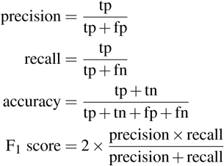
Methodology
Research design :
Data collection :
Tools and techniques
Evaluation

Slide 18
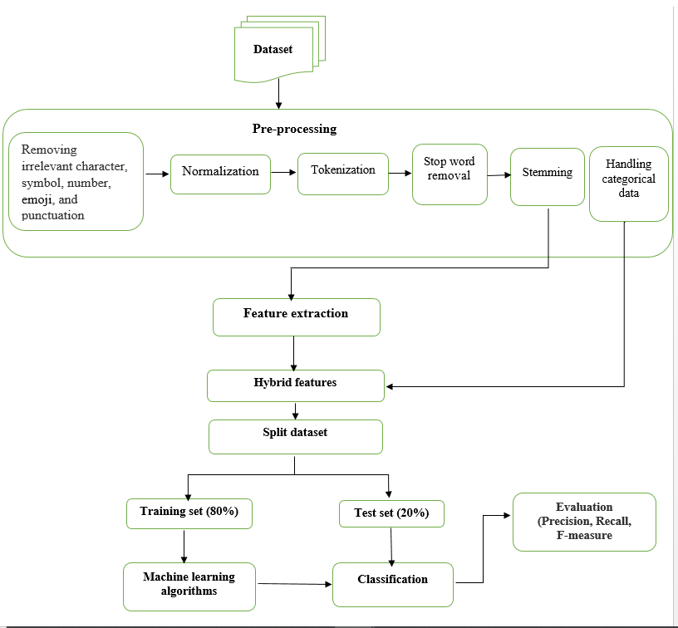
Architecture

Slide 19
Experiments
Experiments | Approach | Features and algorithms
Experiment 1 | Content-based | Unigram with LR, SVM, and RF
Experiment 2 |  | Bigram with LR, SVM, and RF
Experiment 3 |  | Trigram with LR, SVM, and RF
Experiment 4 |  | Word2vec with LR, SVM, and RF
Experiment 5 | hybrid of content and social-based | Unigram + social feature with LR, SVM, and RF
Experiment 6 |  | Bigram + social feature with LR, SVM, and RF
Experiment 7 |  | Trigram + social feature with LR, SVM, and RF
Experiment 8 |  | Word2vec+ social feature with LR, SVM, and RF

Slide 20
Experiments result
Features | Algorithm | Accuracy (100%) | Precision (100% ) | Recall (100%) | F1-score (100 %)
Unigram with TFIDF | LR | 93.35 | 93.33 | 93.33 | 93.33
 | SVM | 89.76 | 90.00 | 89.8 | 89.89
 | RF | 91.5 | 91.47 | 91.5 | 91.48
Bigram with TFIDF | LR | 89.32 | 90.00 | 89.5 | 89.75
 | SVM | 81.69 | 84.57 | 82.0 | 83.16
 | RF | 86.71 | 88.22 | 86.97 | 87.59
Trigram with TFIDF | LR | 76.57 | 83.26 | 77.15 | 80.08
 | SVM | 74.94 | 82.30 | 75.5 | 78.75
 | RF | 79.52 | 84.63 | 80.01 | 82.25
Word2vec | LR | 92.48 | 92.50 | 92.45 | 95.47
 | SVM | 94.22 | 94.28 | 95.24 | 94.75
 | RF | 94.00 | 94.04 | 93.97 | 94.00

Slide 21
Experiments result
Features | Algorithm | Accuracy (100%) | Precision (100% ) | Recall (100%) | F1-score (100 %)
Unigram with TFIDF + Social feature | LR | 96.84 | 97.10 | 96.75 | 96.92
 | SVM | 96.40 | 96.72 | 96.30 | 96.50
 | RF | 99.56 | 99.57 | 99.55 | 99.56
Bigram with TFIDF + Social feature | LR | 96.84 | 97.1 | 96.75 | 95.39
 | SVM | 96.40 | 96.72 | 96.30 | 96.50
 | RF | 99.34 | 99.36 | 99.33 | 99.34
Trigram with TFIDF + Social feature | LR | 96.84 | 97.1 | 96.75 | 95.39
 | SVM | 96.40 | 96.72 | 96.30 | 96.50
 | RF | 99.34 | 99.35 | 99.34 | 99.34
Word2vec + Social feature | LR | 93.79 | 93.80 | 93.77 | 90.87
 | SVM | 96.40 | 96.72 | 96.30 | 96.50
 | RF | 99.67 | 99.68 | 99.66 | 99.67

Slide 22
Discussion
From content based analysis word2vec features have been higher accuracy among other content features. because this feature contain the semantic information of words in the document .
as compared to content based analysis hybrid approach achieves higher accuracy . It shows that hybrid approach is an effective approach other than individual.
Random forest achieve the highest accuracy as compared to SVM and RF

Slide 23
Recommendation
It is best to see the difference in performance outcomes using deep learning algorithm models.
Build a variety of detection methods, other languages such as Tigrigna, AfanOromo, or Sidamegna would be nice to consider.
It would be better for future researchers to incorporate picture analysis.

Slide 24
Conclusion
We used a data collected from Facebook and prepared and annotate for the purpose of feature extraction.
Feature extraction method of word2vec,N-gram and TFIDF feature have been applied on the news content. And a total of 8 experiments have been conducted.
The highest accuracy score is 99.7% when using hybrid of word2vec with social-context feature and RF algorithm.

Slide 25
THANK YOU

Slide 26


